Slide 1

Mocha - Istanbul-
Git - CircleCI
By Josias Moukpe

Slide 2
What are Mocha, Istanbul, Git, CircleCI?
Mocha
Mocha is a JavaScript test framework for Node.js programs.
Open-source
Fullstack testing through additional packages
ChaiJS & Puppeteer JS
https://mochajs.org/
Istanbul (nyc)
Istanbul instruments your JavaScript code with line counters
https://istanbul.js.org/.
Git
Git is a distributed version-control system for tracking changes in source code during software development.
(if you don’t know about git, do us a favor and please leave)
CircleCi
CircleCI allows teams to rapidly build quality projects, at scale.
https://circleci.com/product/

Slide 3
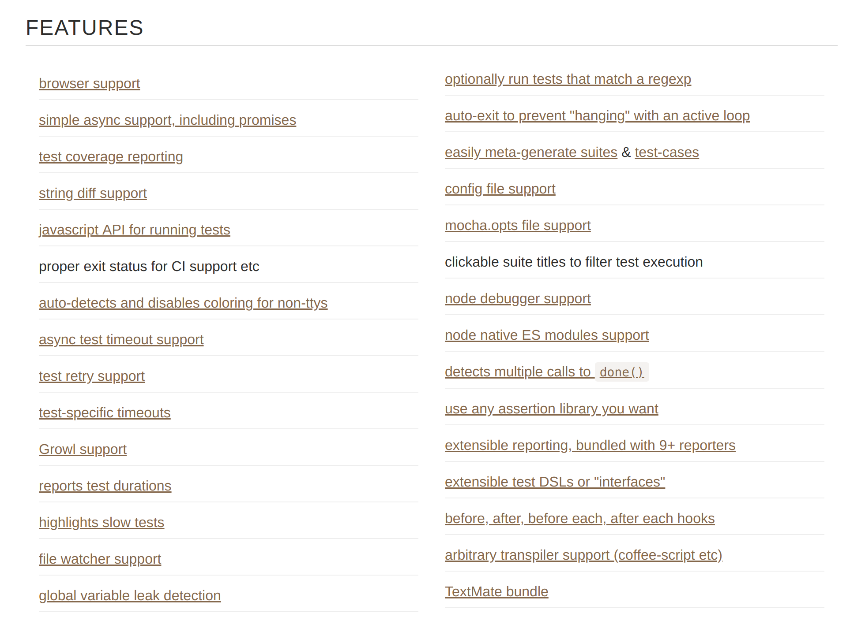
Mocha’s feature

Slide 4
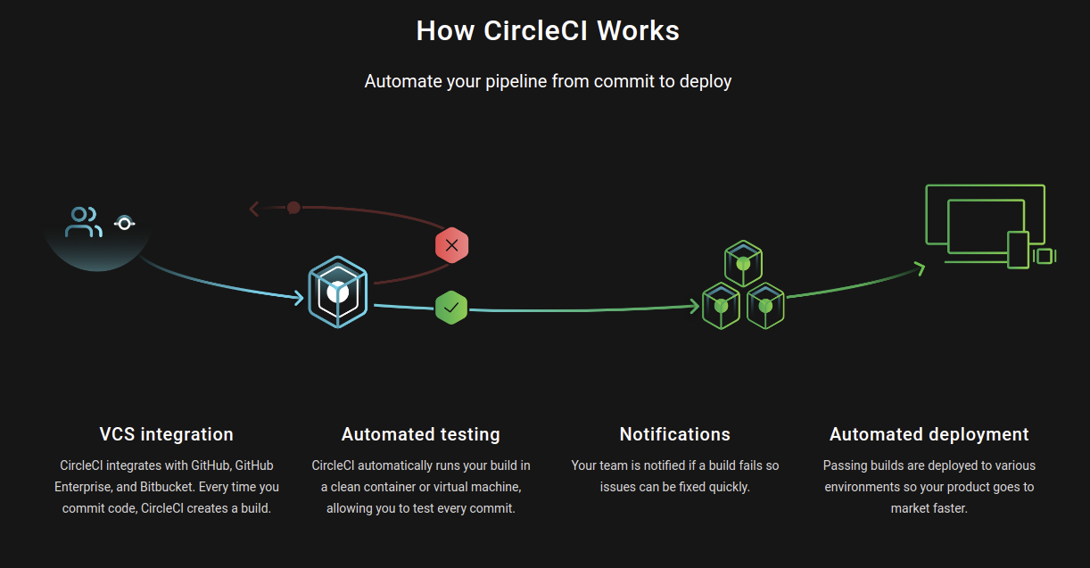

Slide 5
Workflow
Create a Git repo for the app you are building with .gitignore setup to NodeJs
Create a free CircleCI account and add your repo to the testing pipeline
Clone your repo locally and add source codes for your app (npm init, npm install, all routes and js functions)
Add .circleci/config.yml file to setup the parameters of the test
Create a dev branch and protect your master branch using branch protection setup to passing CircleCI test

Slide 6
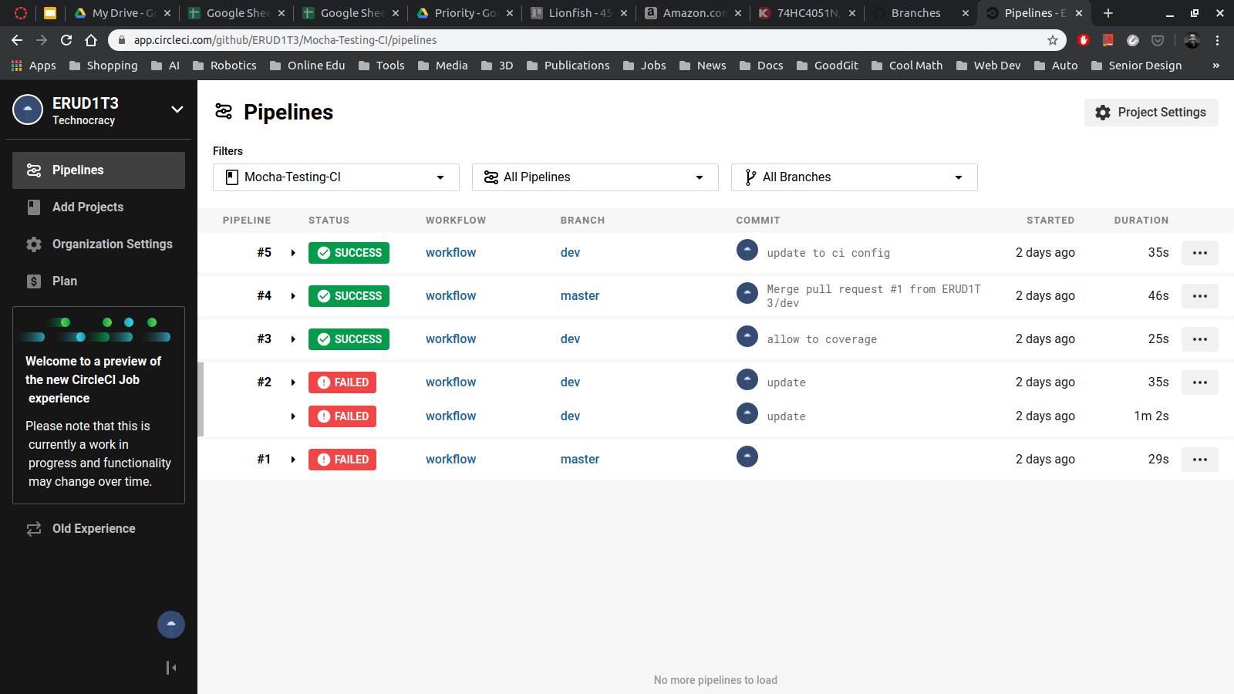

Slide 7
Workflow (continued)
Install mocha and nyc (Istanbul) as dev dependencies
Create a test/ directory in the root directory of your project. It will contain all the source code to test your app’s source codes
Setup couple of tests
Add testing scripts to your package.json file for testing and code coverage
Run test locally (Should pass!)

Slide 8
After several NPM calls later ...

Slide 9
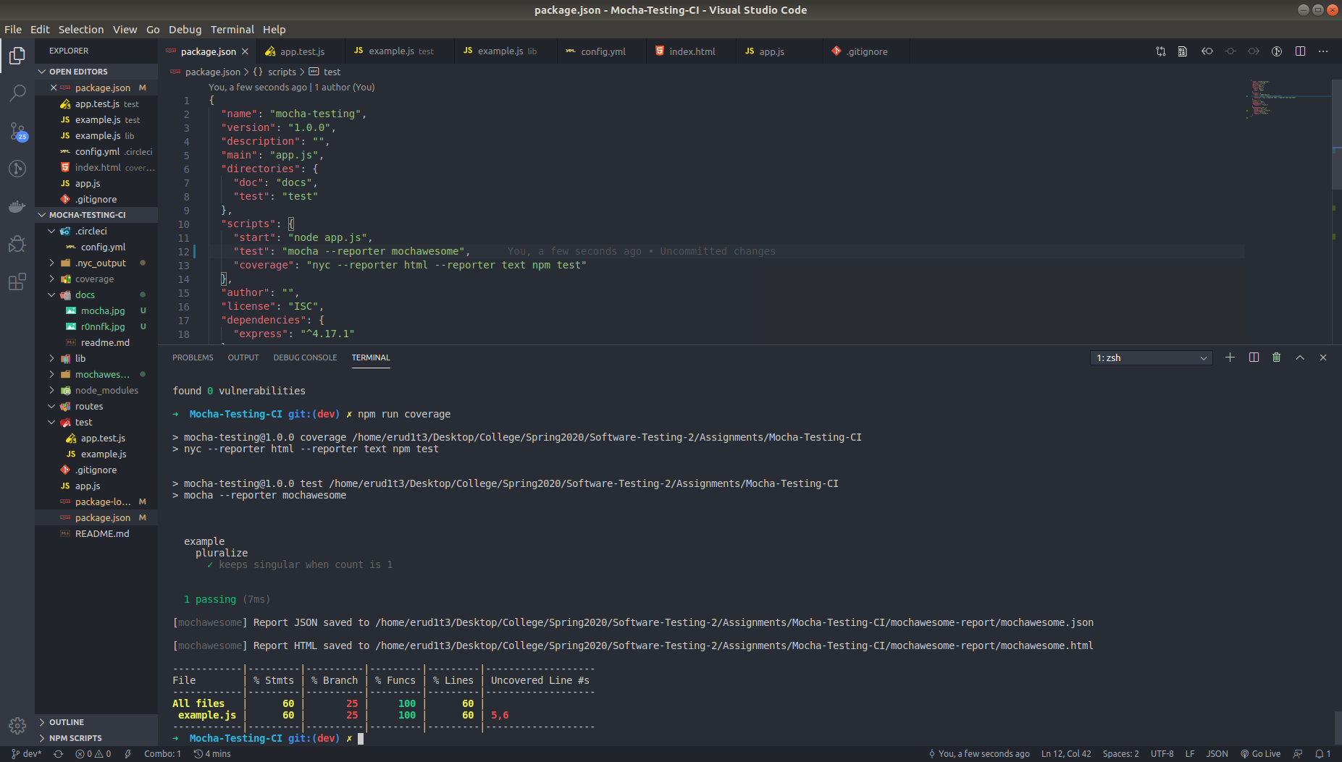

Slide 10
Live Demo (before)

Slide 11
Quick sacrifice to appease the demo gods

Slide 12
Live Demo

Slide 13
Assignment
Create “Hello World” Webapp using NodeJS (5pts)
Make a function called Hello that display a greeting on Webapp’s main page (5pts)
Write test for the function’s output (10pts)
Run the test locally and see the result (test should pass) (5pts)
Change the output of the Hello function and re-run the test (test should fail) (50 pts)

